Slide 1
Advanced Face Authentication & Activity Monitoring System
CSM-962
Supervised by:
Dr. Lotika Singh
Department of Physics & Computer Science
Faculty of Science
Presented by:
Aysha
2401304
M.tech 1st year
Engineering Systems with CS Specialization

Slide 2
Motivation
Increasing demand for secure and fair online examinations.
Growing reliance on remote learning and online assessment platforms.
Need for real-time monitoring to prevent malpractice during exams.
Reducing the burden on human proctors through automation.
Improving the reliability and trustworthiness of online exams.

Slide 3
Problem Statement
Traditional online proctoring methods are limited:
Faces may not be continuously detected.
Suspicious behaviors like looking away, speaking, or getting external help often go unnoticed.
Presence of multiple people during exams is hard to monitor manually.
Existing systems are prone to human error and are not scalable.

Slide 4
Objectives
Real-time Face Detection Continuously detect and track the candidate’s face during the examination session.
Real-time Student Behavior Monitoring Identify suspicious activities such as looking away, speaking, multiple people, and absence from the frame.
Maintain Exam Integrity Minimize cheating attempts and uphold the fairness of online examinations through automated alerts.
Easy System Integration Design a modular system that can be easily integrated with existing online exam portals.

Slide 5
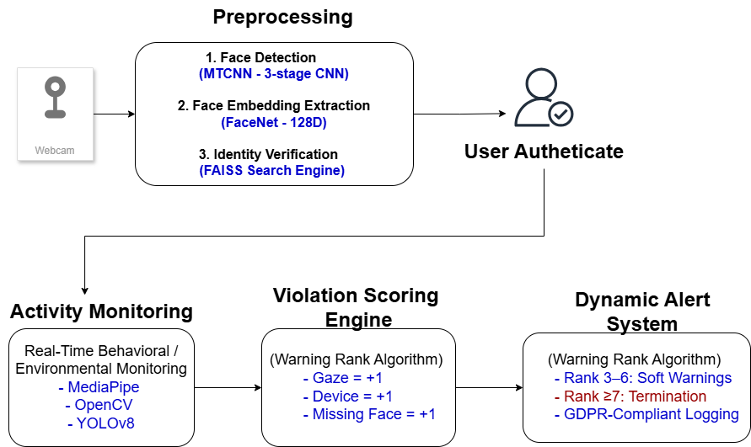
Project Overview

Slide 6
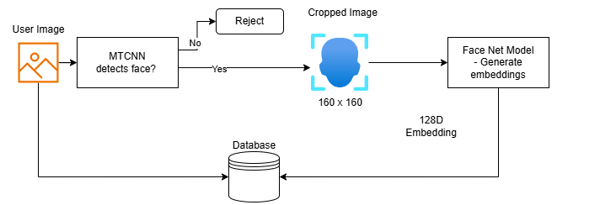
User Registered Workflow

Slide 7

User Login Workflow

Slide 8
Technologies Used
Libraries & Frameworks
TensorFlow (FaceNet training & inference)
PyTorch (YOLOv8 object detection)
OpenCV (Head pose, Optical Flow)
MediaPipe (Face Mesh, Iris Tracking)
FAISS (Fast facial similarity search)
Redis (Real-time event queue)
Flask / FastAPI (REST API serving)

Slide 9
Models
MTCNN → Face Detection & Landmarking
FaceNet (Inception-ResNet-v1) → Face Embedding Generation
YOLOv8 Nano → Object Detection (Phones, books, etc.)
Additional Tools
TensorRT → Model optimization for fast inference
Slack Webhooks / APIs → Instant violation notifications
AES-256 Encryption → Secure Data Storage (Logs)

Slide 10
Methodology - Face Recognition Module
Purpose: Secure authentication through face detection, alignment, feature extraction, and embedding matching.
Face Detection & Alignment (MTCNN)
Three-stage network for precise face detection and landmark alignment.
Optimizations: Low-light enhancement, hardware acceleration (TensorRT).
Feature Extraction (FaceNet)
128-D embeddings using Inception-ResNet-v1.
Triplet Loss for training on the VGGFace2 dataset.
Embedding Matching (FAISS)
Efficient similarity search using FAISS.
Cosine similarity for matching with low false acceptance rate.

Slide 11
Methodology - Activity Monitoring
Looking Away Detection: Monitored using face landmarks and gaze direction analysis (Mediapipe).
Speaking Detection: Detected via audio input analysis for speech activity, synchronized with face movement.
Multiple People Detection: Identified using YOLO object detection to track multiple faces in the frame.
Prolonged Absence Detection: Monitored through absence of face detection or tracking over time.
Unauthorized Electronic Device Detection: (Optional) Analyzed using object detection models to identify devices like phones.

Slide 12
Important Algorithms/Techniques
Pose Estimation: Used to detect head orientation for identifying looking away behavior (Mediapipe or OpenCV).
Mouth Movement Detection: Analyzes facial landmarks around the mouth to detect speaking actions (OpenCV or Mediapipe).
Face Count >1: Uses YOLO for real-time object detection to identify and count multiple people in the frame.
Temporal Analysis: Monitors changes over time to detect prolonged absence by tracking face presence or absence.

Slide 13
System Flow of Face Authentication
VGGFace2
Preprocessing
Training Approaches
Authentication
Django API
Key Components:
MTCNN Face Detection
Dual Training Paths (Transfer Learning vs Triplet Loss)
Embedding Comparison Engine
Django User Management

Slide 14
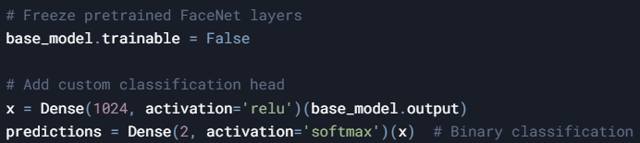
Transfer Learning with FaceNet
Methodology
Frozen base: Preserves facial feature extraction capabilities
Custom head: Adapts to specific authentication task
Performance Summary
Model Size:
24M params (23.4M frozen)
Why it matters: Minimal trainable params = Faster convergence
Training:
10 epochs | Batch Size: 32
Efficiency: <1 hour on T4 GPU
FaceNet Base (Frozen)
Flatten
Dense(1024)
Dense(2)
Notes:
By freezing FaceNet’s base layers, we preserved its ability to extract facial features learned from 2.6M images during pretraining.
The 84.5% accuracy serves as a baseline.
This approach is ideal for scenarios where training data or compute resources are limited.

Slide 15

Feature Extraction with VGGFace
Image Input
MTCNN Detector
Aligned Face
ResNet-50 Embeddings (2048D)
Dense Classifier
Pipeline Breakdown
Test Accuracy: 97.79%
Embedding Dimension: 2048
Training Time: 20 epochs @ 64 batch size

Slide 16
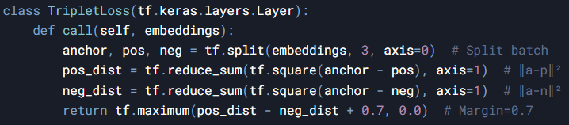
Custom FaceNet with Triplet Loss
Input Triplet
L2-Normalized Embedding (128D)
Triplet Loss Calculation
FaceNet CNN
Training Architecture
Hard-coded margin for separation control
Batch split strategy for triplet formation
Dataset Scale:
176,047 training images (553 identities)
26,124 validation images
Batch Size: 36 (12 triplets/batch)
Technical Hurdles:
GPU Memory: OOM errors with >12 triplets/batch
Convergence: Required 50+ epochs (vs 20 for Approach 2)
Data Pipeline: 4hr preprocessing for 1M images
Notes:
Triplet loss forced 3x data parallelism vs other approaches
128D embeddings reduced storage needs by 16x vs VGGFace (2048D)
Final model achieved 99.2% LFW accuracy despite training challenges

Slide 17
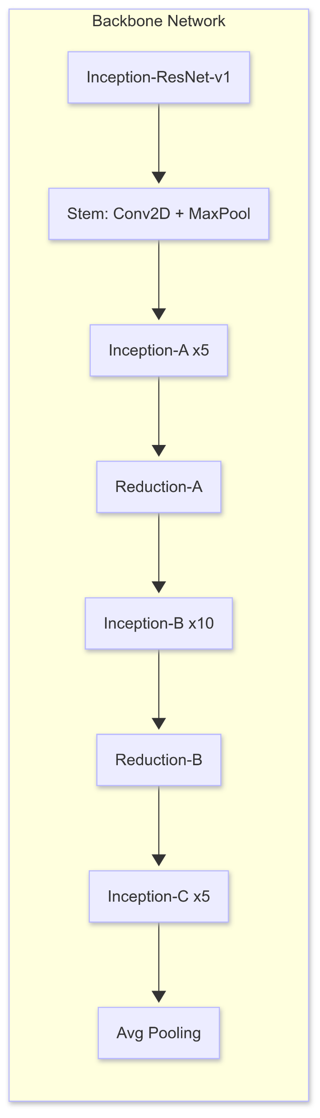
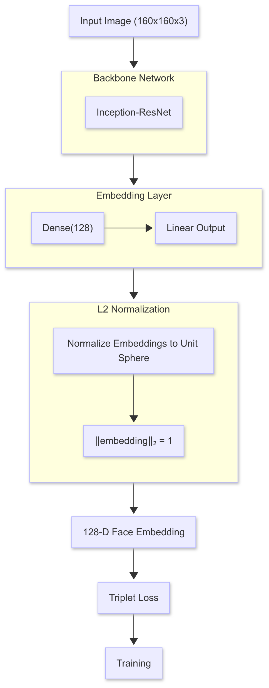
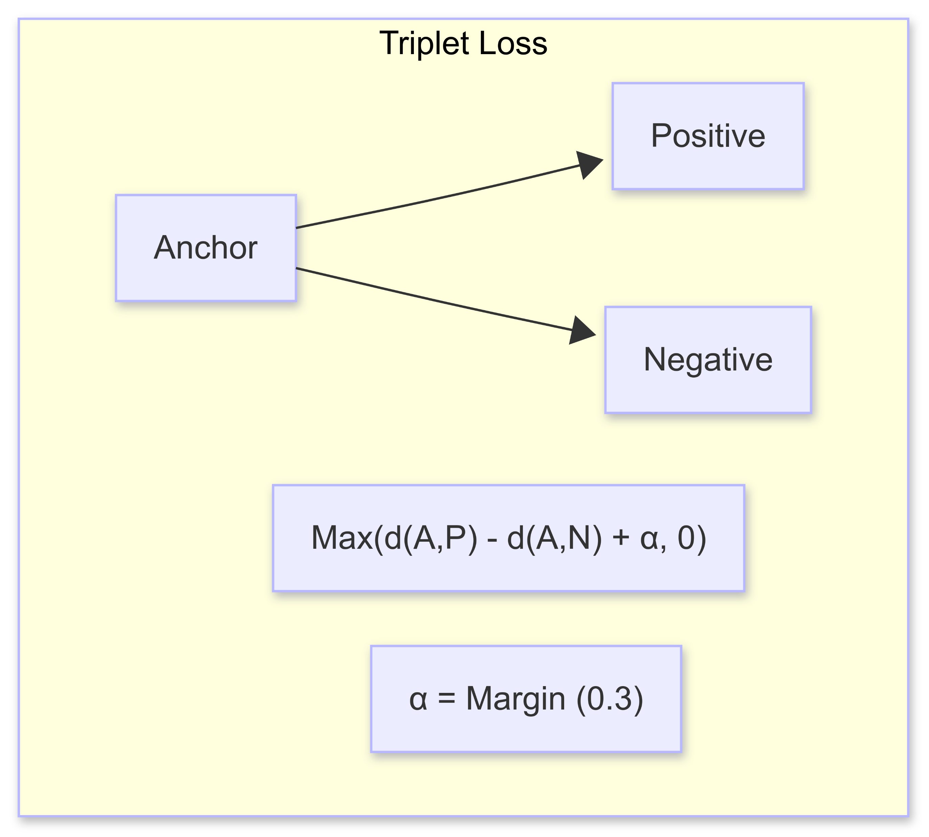
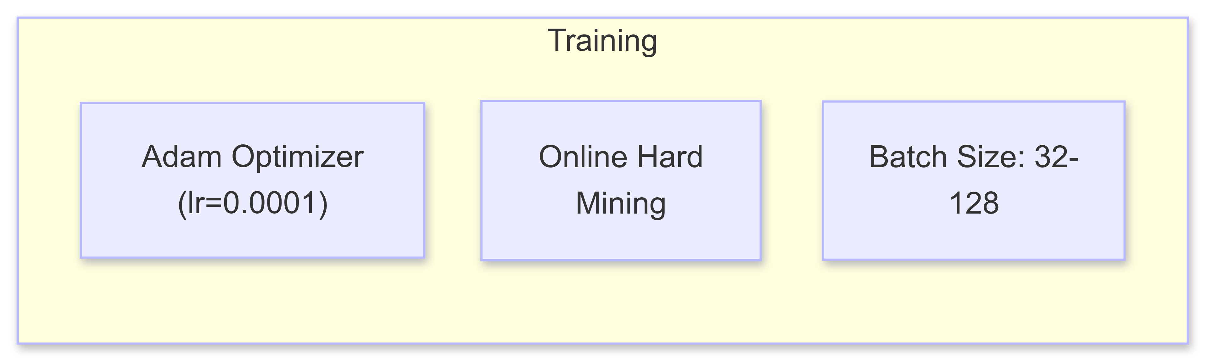
FaceNet Model Architect Workflow

Slide 18
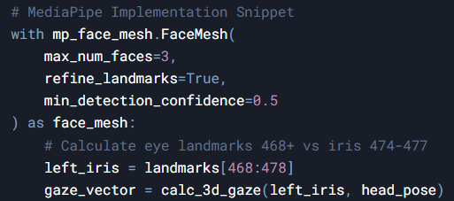
Activity Monitoring System
1. Gaze Tracking Pipeline:
68-point facial landmarks @ 30 FPS
3D head pose estimation (pitch/yaw/roll)

Slide 19
Absence Detection
Person-of-interest identification via embeddings
Alerts triggered after 5s of unrecognized presence
Multi-Face Detection
YOLOv8-based detection (2+ faces simultaneously)
Priority tagging for registered users
Anomaly Alerts
Rule-based triggers:
Unauthorized personnel (>90% confidence)
Prolonged absence (>30s)
Gaze diversion during sensitive operations

Slide 20
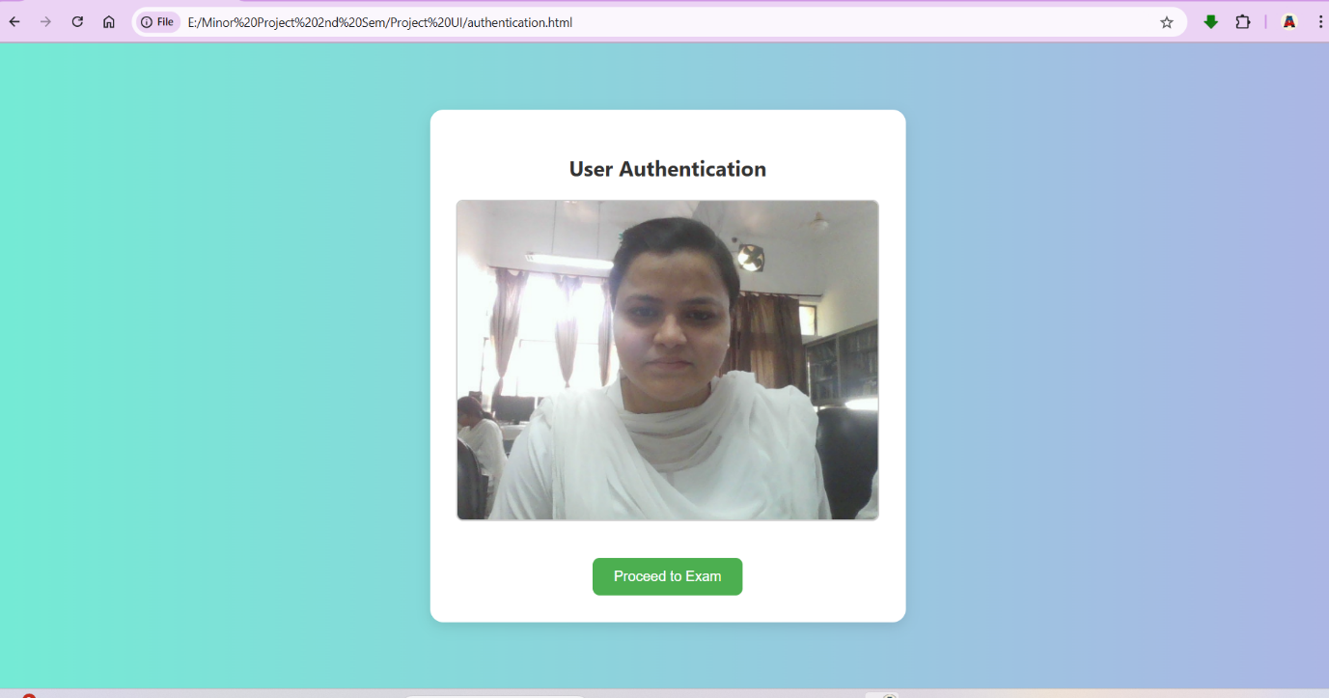
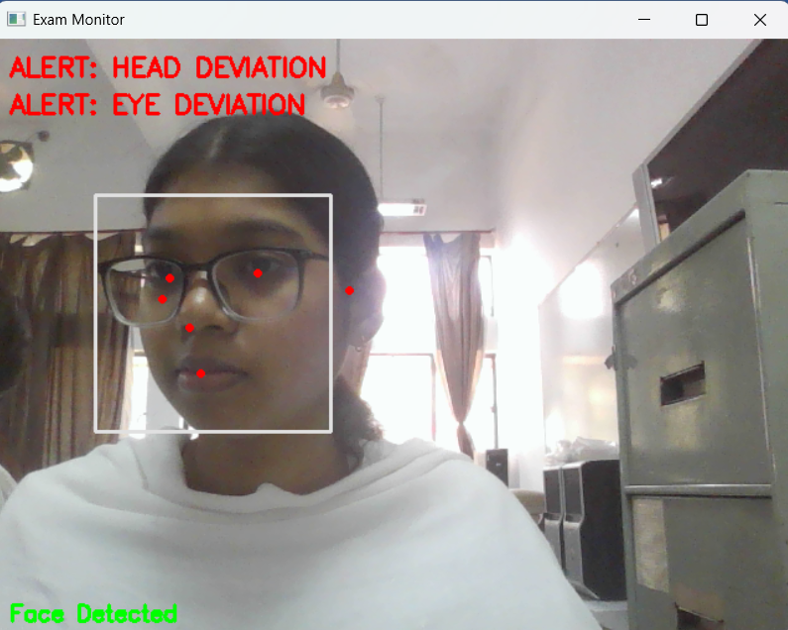
Results
showing successful face detection in real-time
showing the detection of a student looking
away during the exam

Slide 21
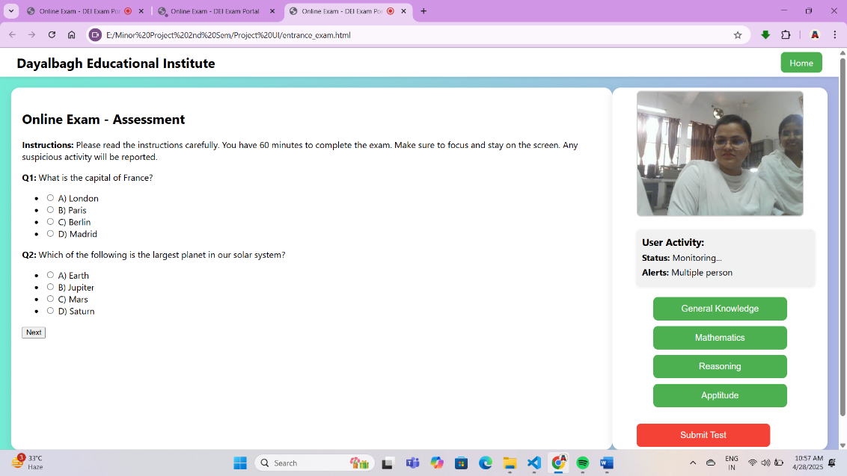
Showing the alert when more than one person is detected

Slide 22
Challenges Faced
Real-Time Processing Issues:
Ensuring low latency for real-time face detection and activity monitoring during exams, especially with varying hardware capabilities.
False Positives/Negatives:
Balancing detection sensitivity to avoid false positives (e.g., incorrectly flagging behavior) or false negatives (e.g., missing suspicious actions).
Handling Different Lighting/Background Conditions:
Dealing with varied lighting and backgrounds in different environments, which affects the accuracy of face detection and behavior monitoring.

Slide 23
Limitations
Dependence on Lighting Conditions:
Face detection and activity monitoring accuracy can degrade in low-light or highly variable lighting conditions.
Limited to Webcam Quality:
The system performance is heavily dependent on the quality of the webcam or camera used by the student.
False Negatives in Complex Scenarios:
Some subtle cheating behaviors (e.g., looking at notes placed near the screen) may go undetected due to limitations in detection algorithms.
Performance in Large-Scale Deployments:
The current system may struggle to scale efficiently for large numbers of simultaneous exam candidates.
Limited Behavior Detection:
Only a few behaviors (looking away, speaking, multiple people, absence) are detected; other forms of cheating may not be monitored.

Slide 24
Conclusion
Successfully developed a system for face detection and activity monitoring during online exams.
Implemented features such as looking away detection, speaking detection, and multiple people detection for enhanced exam security.
System operates in real-time, providing alerts to prevent cheating during online assessments.
The system ensures secure authentication and real-time monitoring, making it difficult for candidates to cheat or impersonate others.
Provides an added layer of integrity for online exams by detecting suspicious behaviors and preventing unfair advantages.

Slide 25
Future Work
Improving Detection Accuracy:
Enhance existing models and algorithms to improve the accuracy of behavior detection, especially in challenging environments.
Handling More Types of Cheating Behavior:
Expand detection capabilities to include behaviors like use of unauthorized materials or multiple device detection.
Mobile Device Integration:
Develop a mobile version of the system to monitor exams taken on mobile devices, providing a more flexible and scalable solution.
Full API-Based Deployment:
Integrate the system into exam portals through an API, enabling seamless deployment for institutions conducting online exams.

Slide 26
Refrences
[1] MTCNN Implementation GitHub Repository: https://github.com/ipazc/mtcnn
[2] S. Chen, Y. Liu, X. Gao, and Z. Han, "MobileFaceNets: Efficient CNNs for Accurate Real Time Face Verification on Mobile Devices," arXiv preprint arXiv:1804.07573, Apr. 2018. https://doi.org/10.48550/arXiv.1804.07573.
[3] K. Zhang, Z. Zhang, Z. Li, and Y. Qiao, "Joint Face Detection and Alignment Using Multi-Task Cascaded Convolutional Networks," arXiv preprint arXiv:1604.02878, Apr. 2016. Available: https://arxiv.org/abs/1604.02878.
[4] VGGFace2 Dataset Documentation: https://www.robots.ox.ac.uk/~vgg/data/vgg_face2/
[5] Q. Cao, L. Shen, W. Xie, O. M. Parkhi, and A. Zisserman, "VGGFace2: A dataset for recognising faces across pose and age," arXiv preprint arXiv:1710.08092, Oct. 2017. Available: https://arxiv.org/abs/1710.08092.

Slide 27
[6] M. Mugalu, K. Kipkemei, and P. Onyango, "Face Recognition as a Method of Authentication in a Web-Based System,2021.
[7] Mediapipe Documentation: https://mediapipe.dev
[8] DeepFace GitHub Repository https://github.com/serengil/deepface
[9] “Django Documentation”, https://docs.djangoproject.com
[10] “Ultralytics YOLO11”, https://docs.ultralytics.com/models/yolo11/
[11] FaceNet Documentation and model https://www.kaggle.com/code/yhuan95/face-recognition-with-facenet
[12] “Open CV documentation” https://docs.opencv.org/4.x/d4/d2f/tf_det_tutorial_dnn_conversion.html
[13] “Tensorflow Documentation” https://www.tensorflow.org/api_docs
[14] “MediaPipe Face Mesh” https://github.com/google-ai-edge/mediapipe/blob/master/docs/solutions/face_mesh.md
[15] TensorFlow/Keras Model Saving & Loading Guide: https://www.tensorflow.org/tutorials/keras/save_and_load

Slide 28
THANK YOU

